Slide 1
Qualifying Surface and Device Performance Through Roughness Quantification Samuel.Lesko@bruker.com

Slide 2
Welcome to the webinar
For best audio experience, everyone is on mute
For question, use the Chat
Questions will be answered at end of webinar
Webinar is recorded and will be available offline
Feel free to share & forward to colleagues

Slide 3
What you will learn today
How to select best means to measure roughness for your applications
When to decide between profile & areal roughness measurement
Which benefits areal S parameters from ISO 25178 bring
Which filter cut-off to chose for meaningful roughness
What the most relevant parameter(s) is (are) versus specific applications

Slide 4
Forewords

Slide 5
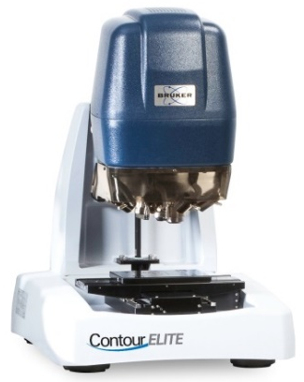
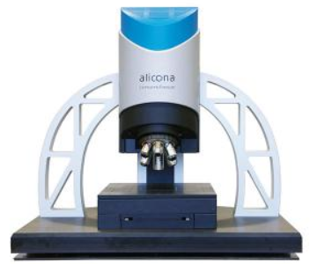
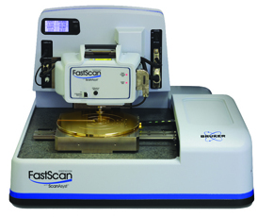
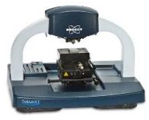
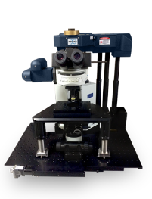
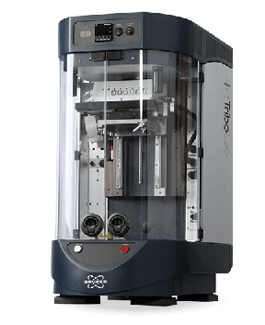
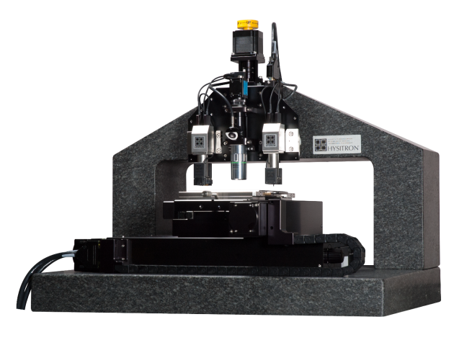
Background Part from Bruker – Nano Surfaces division
3D Optical Microscopy
WLI & Focus Variation from Bruker Alicona
Atomic Force Microscopy
Stylus Profilometry
Bruker Nano Surfaces Division Pioneers in Microscopy, Metrology & Mechanical Testing
Universal Tribology
& Mechanical Testers
Hysitron Nanomechanical Test Instruments
MultiPhoton, Super Resolution
Fluorescence Microscopy

Slide 6
Roughness measurement Needs in Industry
Quantify Wear…
Failure investigation
Design for longer life
Life time warranty
Quantify Texture…
Converge to efficiency
Environmental: low noise, leak, emission
Aesthetics: vibration, appearance
Quantify Manufacture Process…
Monitor production
Production cost
Choose supplier

Slide 7
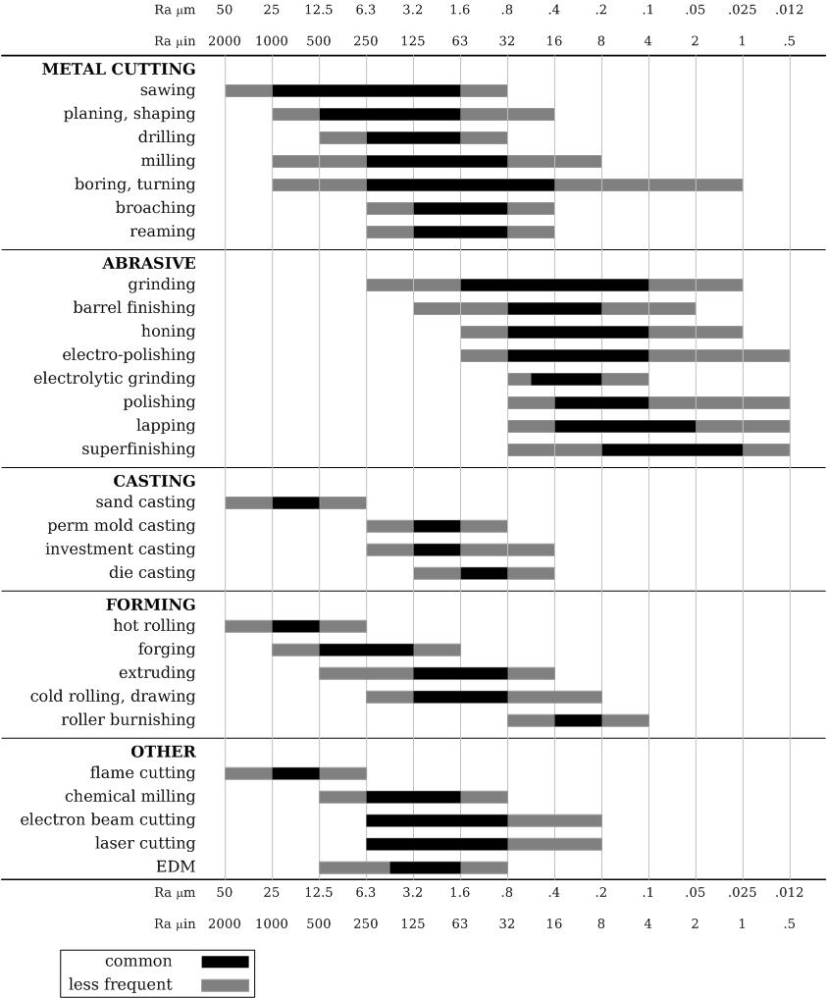
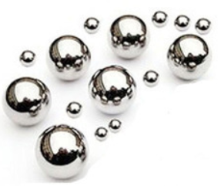
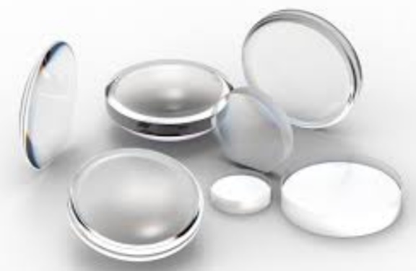
Roughness measurement Range

Slide 8
Roughness measurement Profile vs. Area
Roughness has been measured for decades via profile cross section
What industrial surfaces lend themselves to area inspection?
CNC surfaces (turning, grinding, milling…)
Single Profile
Area measurement
Textured Surfaces (honing, laser,…)
Multi - Single Profiles
Area measurement
Random Surfaces (defect, additive manufacturing, abrasive…)
Single Profile
Area measurement

Slide 9
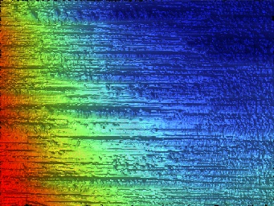
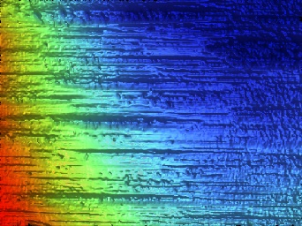
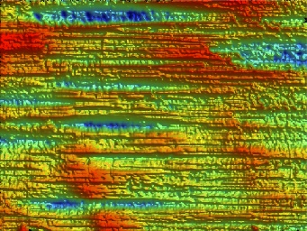
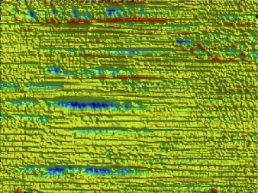
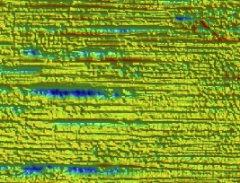
Roughness measurement Norms
ISO 4287 & ISO 3274: cut-off defined by norm
Raw surface
Primitive Surface
Low pass / noise & spike removal
S-F Surface
Shape/form removal
S-L Surface
High Pass for roughness
Definition of area
Extraction S parameters
ISO 25178: cut-off is defined by user

Slide 10
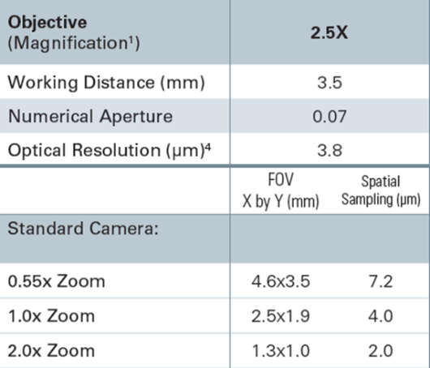
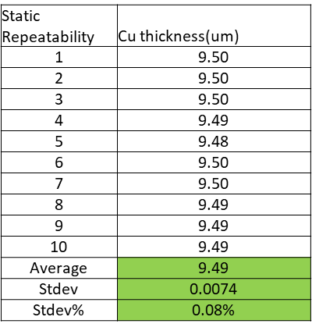
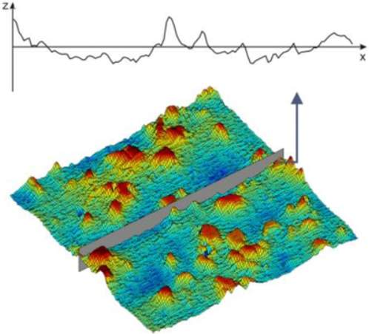
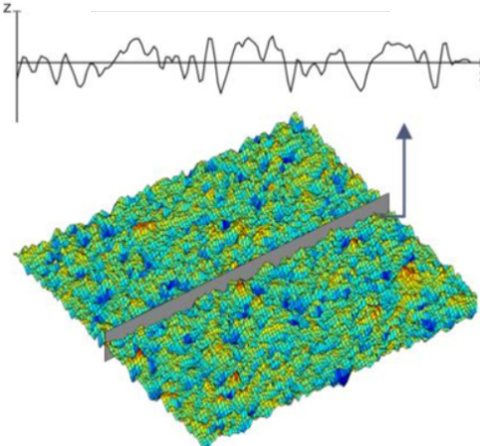
Roughness measurement Potential pitfalls
1. Does instrument have proper lateral resolution?
2. Does instrument have adequate vertical resolution?
3. Does instrument have proper transfer function ?

Slide 11
Technologies to measure roughness

Slide 12
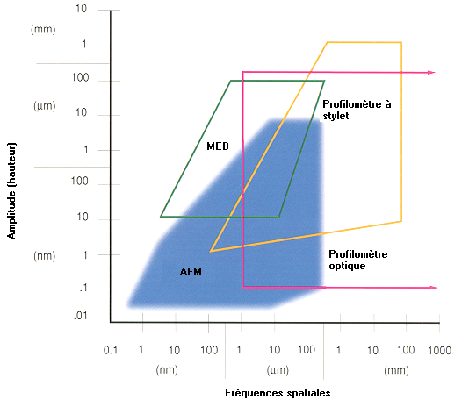
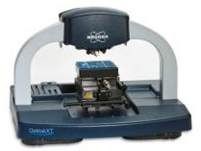
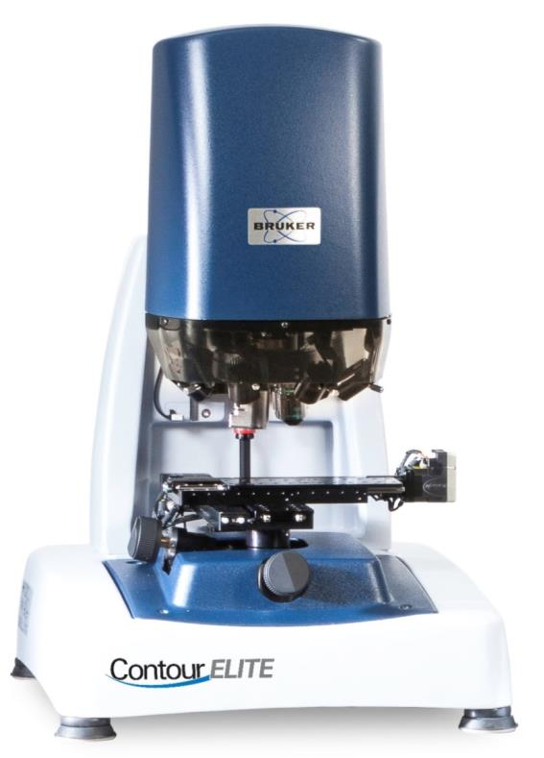
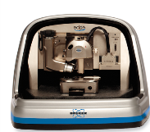
Roughness measurement Which system to select?
Focus Variation
Area
SEM
NO TOPO
Sylus
Profile
Height
Textured / Slope
Thin film < 0.1µm
White Light Interferometry
Area
Profile
Vertical Precision < 0.1µm
Lateral resolution
Lateral details < 0.5µm

Slide 13
White Light Interferometry Principle
Pixel Intensity
Camera
Vertical scan
Best contrast
Moiré présence
Notes:
FV is not new.

Slide 14
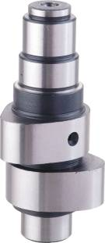
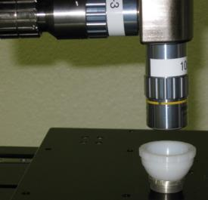
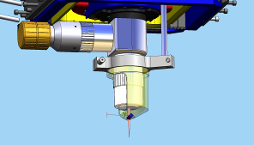
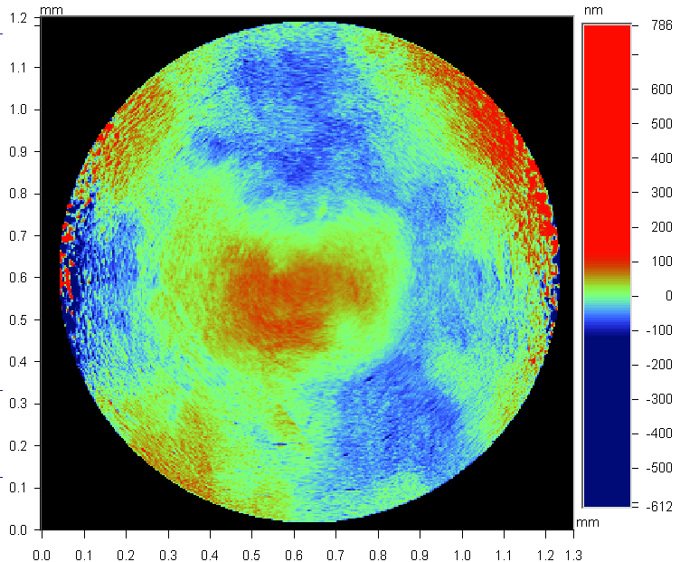
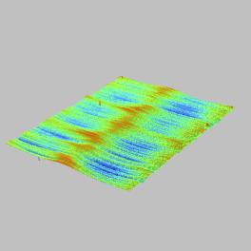
White Light Interferometry Vertical resolution in all situations
Sa = 0.03 µm !!!
Fold mirror for vertical wall charterization
Sa = 0.1µm!!!
No other optical profiling technique combines vertical resolution over large areas

Slide 15
White Light Interferometry Large dynamic & transfer function
Sa= 2.85µm – λc > 0.8mm
2 images
4.02 x 1.74 mm²
3.6µm lateral resolution
Sa= 1.06µm – 0.08mm<λ <0.8mm
Sa=0.25µm – 0.008mm<λ <0.08mm
Unique vertical sensitivity versus all other non-contact profiling techniques
Surface component
Full vertical range: 10µm
True vertical resolution: 1nm

Slide 16
Beyond mean roughness

Slide 17
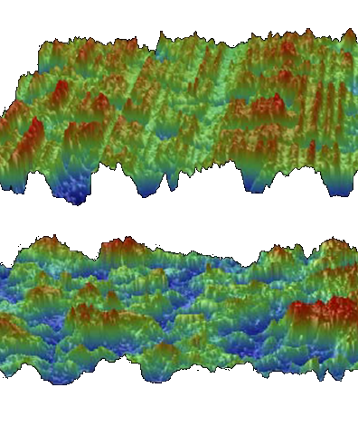
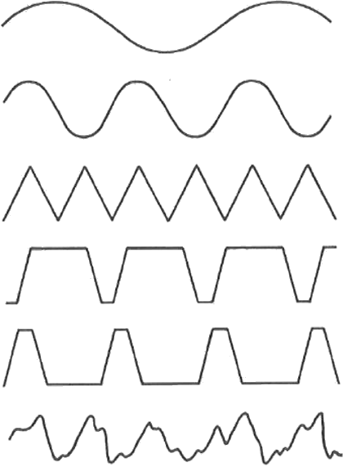
Roughness measurement Why Ra or Sa are not enough?
Same Ra
Same Sa

Slide 18
Case study

Slide 19
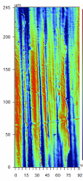
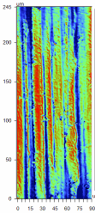
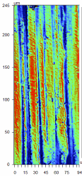
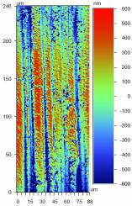
GAR Strip Corrosion Measurements How top choose cut-off?
Peaks
Examined various surface finishes for rate of corrosion over longer time period
Similar Trends on increasing roughness and randomness of the surface
Rougher surfaces corroded to greater degree
Valleys
Same
Power Spectrum Density gives indication on which cut-off to select
Different
High
Low
Notes:
In a similar corrosion study as the last example, a steel surface is studied.
Surface finish is quantified.
GAR is the commercial name for a test strip of steel with difference textured surfaces and nominal roughnesses.

Slide 20
Reflectivity efficiency Al coated mirror
Power Spectrum density emphasizes which spatial frequencies are the most important
In this case, intermediate spatial frequencies are key for appearance

Slide 21
Reflectivity efficiency Al coated mirror
Sa = 13.7nm
Proper spatial filtering reveals through mean roughness Sa differences between mirrors
Increase of roughness amplitude also increases diffusion of light
Diffusion directly scopes with reflectivity efficiency
Mate appearance
Sa = 6.5 nm
Shiny appearance

Slide 22
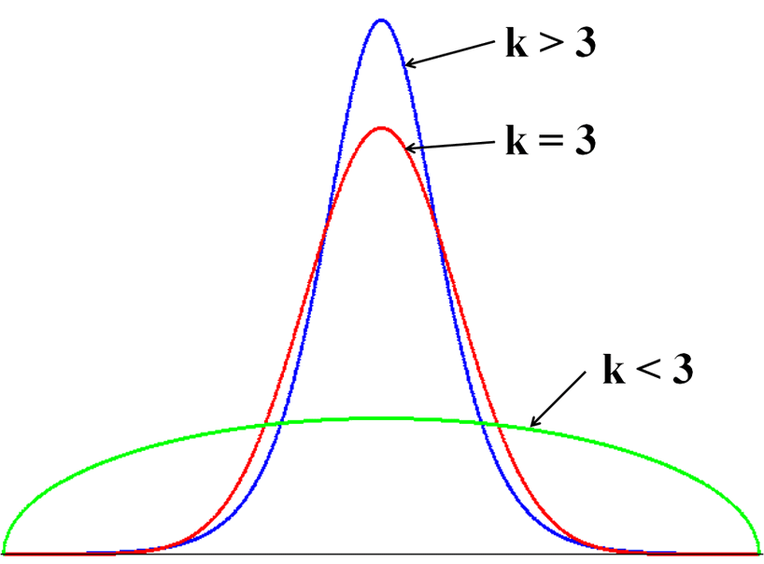
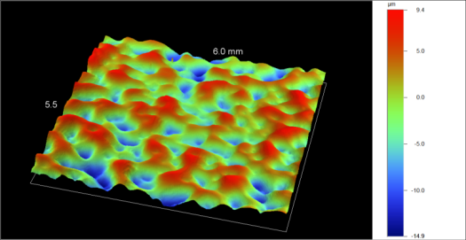
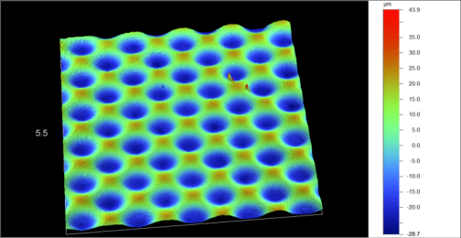
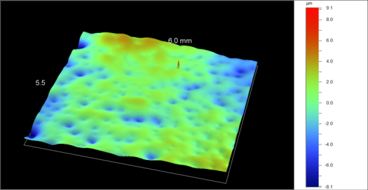
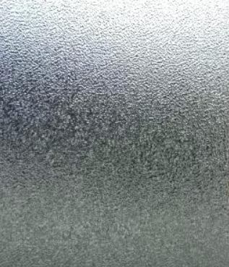
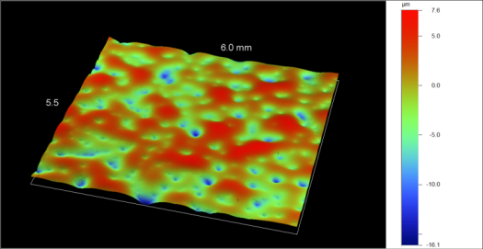
Quantification of opacity Glass manufacturing
Kurtosis
Roughness filtered | Sku
Rough Side | 40
Soft Side | 10 000
Mat Side | 1 000
Prism Side | 200
Notes:
Please use:
Boxes with GREY outlines for pictures and text
Boxes with RED outlines for text only.
FULL GREY boxes for conclusions only.

Slide 23
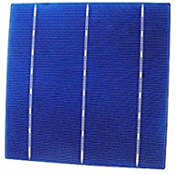
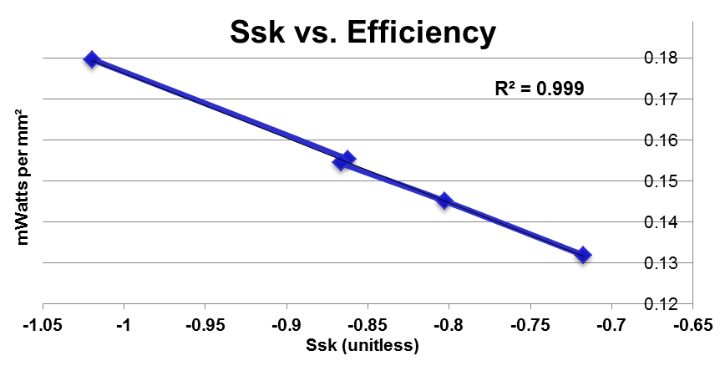
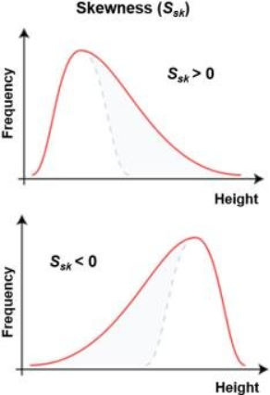
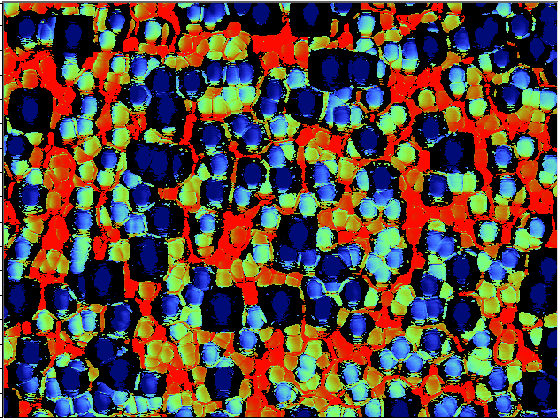
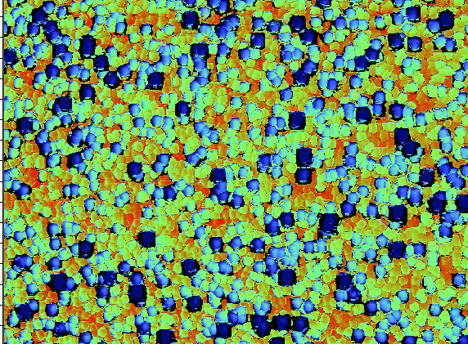
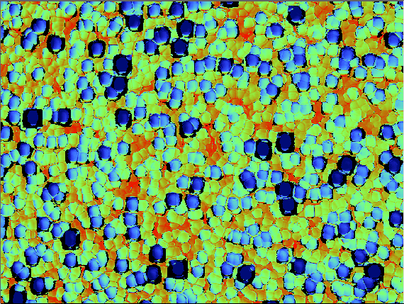
Quantification of efficiency Solar Cell
23
Notes:
23

Slide 24
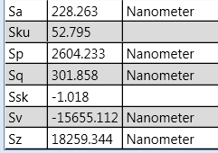
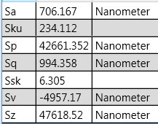
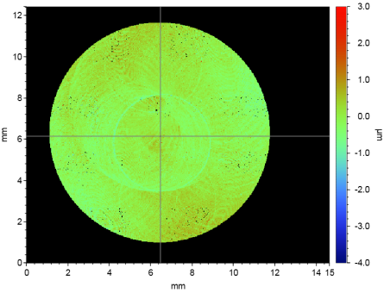
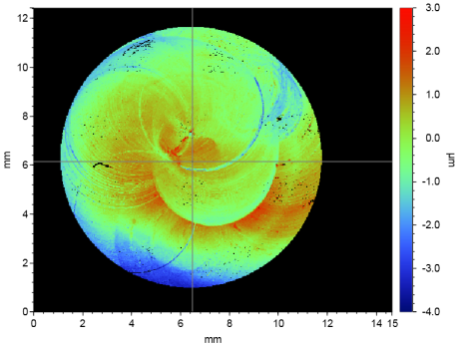
Entry qualification Cap for ultra-sound sensor
Good performances
Issues with coupling
X4 difference
X6 difference
Notes:
Please use:
Boxes with GREY outlines for pictures and text
Boxes with RED outlines for text only.
FULL GREY boxes for conclusions only.

Slide 25
Wear assessment Cylinder – Functional parameters
New
Used
1 mm
Vmp | 25 x 10⁻⁶
Vvc | 8.0 x 10⁻⁴
Vvv | 11.0 x 10⁻⁵
Vmp | 8.3 x 10⁻⁶
Vvc | 1.5 x 10⁻⁴
Vvv | 1.8 x 10⁻⁵
Abott / Firestone / Bearing curve
Vmp: peak material volume
Vvc: core void volume
Vvv: lubricant reservoir volume
Unit: (µm³/µm²)
Risk of adhesive behavior with piston

Slide 26
Quantification of gloss Metal Belt ring
Glossy
Shiny
BAD
GOOD

Slide 27
Quantification of gloss Metal Belt ring
GOOD: shiny
BAD: too mate
There is clear differentiation of good/bad glossy surfaces for belt. Average slope variation indicates how shinny surface is with clear quantification.

Slide 28
Finding root cause of issue Brake vibration
Quiet
Noisy
Sa: In spec
Sdq: Low
Sa: In spec
Sdq: High
Sharp well-defined triangular shape allows proper grid on disk
Spatial frequency plays a role here
Sdq combines
Amplitude
Lateral spacing

Slide 29
Predictive maintenance Sealing on rotating shaft
Sa | 368nm
Sds | 1130 /mm²
Ssc | 49 mm⁻¹ (radius 20μm)
New shaft
600 µm
Used shaft
Sa | 769 nm
Sds | 247 /mm2
Ssc | 6 mm-1 (radius 166 mm)

Slide 30
Optimization of process 3D printing of PEEK material
Sal = 77µm
Sal = 88µm
Notes:
Measure high lateral resolution along line

Slide 31
S areal roughness parameters Link with functionality
Strong Correlation
Weak Correlation
No Correlation

Slide 32
Conclusion
3D optical profilometry allows proper description of complex texture of surface by areal measurement
Through large field of field and use of new ISO roughness parameters, 3D optical profiler techniques are able to rank surface effiency as well as to explain the reasons for failure
Selection of optical & stylus technologies is application dependant
Stylus:
quick long single trace
multi-thin transparent layers < 100nm
Focus Variation: large field with roughnesss
White Light Interferometry:
large field of view with sub-µm roughness
high lateral resolution

Slide 34
Sensor sensitivity When roughness is not enough
+50%
+20%
Good
Bad

Slide 35
Best Practices Roughness not always enough

Slide 36
Std – Spatial S-Parameter cont.
The figure below shows an image that has surface lay in it. It lays on the left side of the Y axis so Std = -17 deg
When the surface is isotropic then there is no lay present, so Std will read as N/A.

Slide 37
Machining Influence on Texture Example 3D Areal Images – NB Directionality
Flat lapping/Reaming
Grinding
Horizontal Milling
Turning
Vertical Milling

Slide 38
S Parameters – Hybrid Parameters (Sdq, Ssc, Sdr)
Sa=994nm, Sdr- 1.6%
Sa=1173nm, Sdr- 0.5%
Sdr may further differentiate surfaces of similar amplitudes and average roughness. As indicated above, two surfaces with only a difference of 10% in Sa have over a 200% difference in Sdr. Typically Sdr will increase with the spatial intricacy of the texture whether or not Sa changes.
Sdr is useful in applications involving surface coatings and adhesion. Sdr and may also find relevance when considering surfaces used with lubricants and other fluids. Sdr may be related to the surface slopes and thus may also find application related to the manner in which light is scattered from a surface.

Slide 39
1D Roughness measurement On textured cylinder
Native
Roughness filtered profiles – Gaussian filter – cut-off 0.8mm
Corroded

Slide 40
Reason for areal roughness
Gear edge has multiple high angles (90 degrees) and must be characterized in 3D
2D calculations cannot reliably determine the geometry or roughness
WARNING: multiple 2D lines to build « 3D » require extra attention on how lines are paste together

Slide 41
Orthopedic – Mean Roughness Qualification of polishing process on knee prostheses
Raw Casted Finish step 1 Finish step 2 Final hand buff

Slide 42
Clutch & coupler Bearing metrics Sbi, Sci, Svi
Clutch = grip surface
Coupler = transferring motion
Sa = 1.2 um Sbi=0.70 Vvc/Sz=1.31 Vvv/Sz =0.12
Sa = 4.2um Sbi=1.43 Vvc/Sz=0.46 Vvv/Sz =0.23

Slide 43
Car boards Spotting the difference on large areas
Ghosted
Non-Ghosted
More micro-structures seen in valleys

Slide 44
S parameters show how they are different

