Slide 1
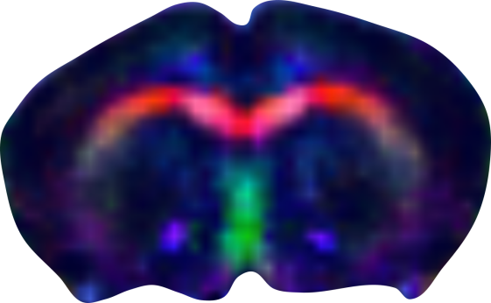
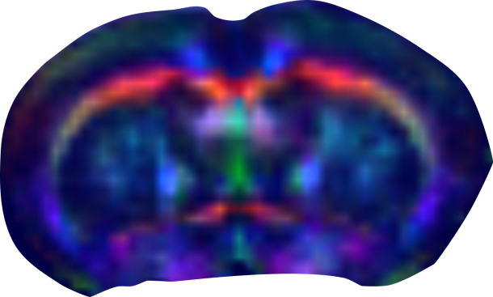
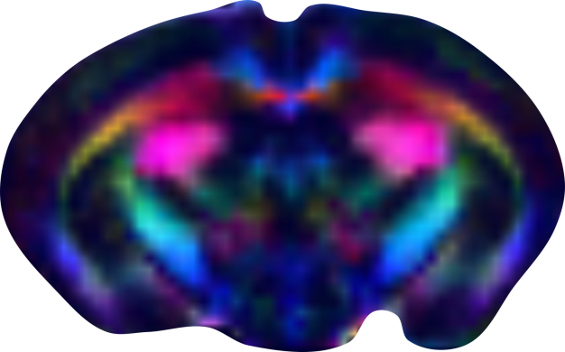
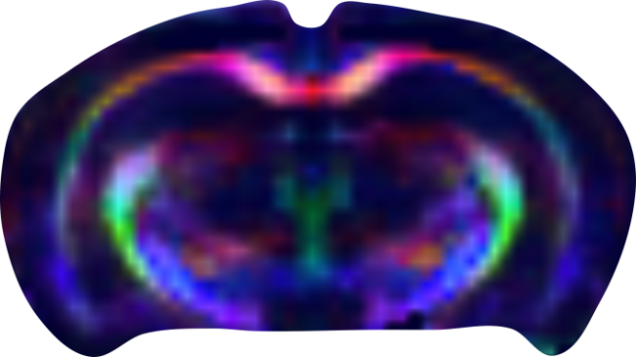
[Title] [Optional subtitle]
Bruker MRI Award 2024
[Purpose (Why?)]
[Methods 1]
[Methods 2]
[Outcome 1]
[Relevance/Perspective]
Courtesy: [Authors], [Institute], [Country]
[Optional: Reference: paper/abstract reference]

Slide 2
Early Detection of Alzheimer's Disease in Mice Structural Connectivity as a Biomarker
Bruker MRI Award 2024
Does DTI allow us to determine the early onset of Alzheimer's Disease (AD)?
Mouse brains were examined using EPI-DTI at 3T
A group of 10 AD mice was compared to 10 controls
AD could be detected via structural connectivity as early as week 2 in newborns
Structural connectivity proves to be an excellent AD detection and allows earlier detection than conventional methods
Courtesy: Dr. X, Preclinical Imaging Center, University of Ettlingen, Germany Reference: X et al., MRM 2018
Notes:
Acquisition details:
Animal Model: Bl6 mice
Anesthesia: Isoflurane 1%
MR:
System: BioSpec 30/18
Coils used: Circularly polarized 82 mm volume coil for transmission, mouse brain phased array coil for signal reception
Method: Single-shot DTI-EPI
Contrast agent: Resovist® 2µl/g body weight
TE/TR: 25/2300 ms
Resolution: (188 × 188) µm²
Slice Thickness: 1 mm
Scan Time: 20 min
Comment: Minimal distortions, 240 diffusion directions, B = 650 mm/s²
PET:
System: N.A.
Tracer: N.A.
Activity: N.A.
Resolution: N.A.
Scan Time: N.A.
Comment: N.A.

